Slide 1

2021
HIGHLIGHTS

Slide 2
Executive/Plenary Session
VIDEOS
21 SEP (ESC & Plenary Session)
Morning (ESC): https://youtu.be/cGWbchM-n78
Afternoon (Plenary): https://youtu.be/e-gGMUEvihY
14-16 SEP NBAC ANNUAL MEETING
https://www.youtube.com/playlist?list=PLWEnz1sVMlkp3lQPHea424M2q3ZXMx4Z2
2

Slide 3
Executive/Plenary Session
Highlights
NIEM Overview – Where We Want To Be (Stewart Whitehead)
Big Picture, Looking Back, Where We Want to Be
Executive Focus
NIEM Standard Options and Decision
NIEM Governance Review and Decision
New Domains
L&D (ADL) & HIS (Govt. of Canada)
3

Slide 4
KEYNOTE SPEAKER
Mr. Stuart Whitehead (SES)
Deputy Director, Cyber & Command, Control, Communications & Computers Integration, Joint Staff J6 Executive Director – NMO, US Department of Defense

Slide 5

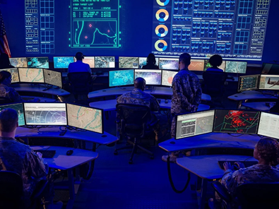

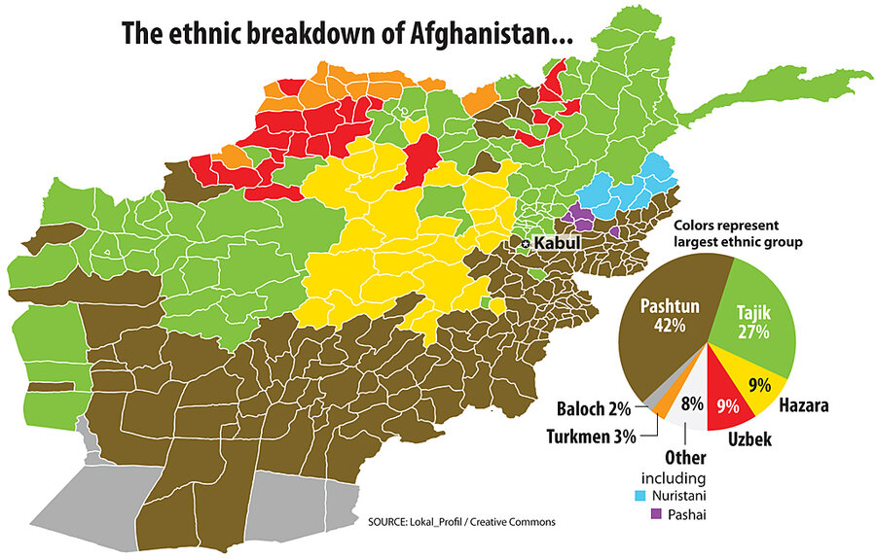

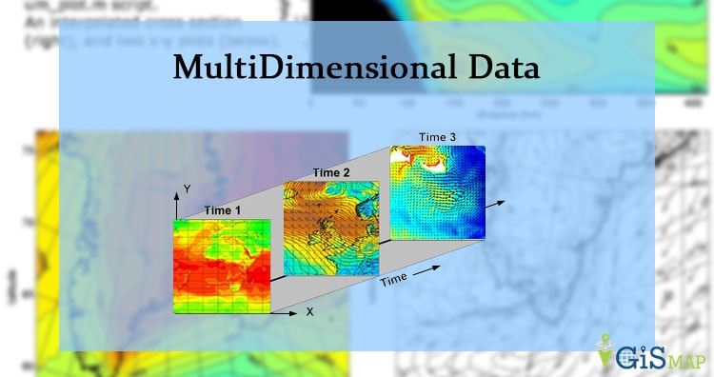
Where we are going – Big Picture
Interoperability as a Nation
Technology is making the world smaller, we need to foster machine to machine interoperability.
Keeping up with the speed of change, Data is at the heart of it all.
Emerging technologies
Artificial Intelligence (AI)
Cloud Computing
Multi-dimensional Data
JADC2
JADC2
Competitively Intelligent on a Global scale!
Notes:
Moore's Law states that we can expect the speed and capability of our computers to double every couple of years, and we will pay less for them.
But there is hope. A new generation of tools and technologies is on the horizon. They hold the potential to transform the speed and ease at which companies can extract value from their data and form impactful insights—all while maintaining evolving security and compliance standards.

Slide 6

Looking Back on 2021
2021 FOCUS
Exploring NIEM as a Standard
Internationalization
Metamodel
Release 5.1
Domain Mentorship
NIEM Content Maturation
Increase NIEM Adoption
Operating in a Virtual Business Environment
6

Slide 7

Where we want to be
2022 Focus
Transition NIEM to be a Standard
Internationalization
Encourage International Leadership
Expand Language Outreach
Domain Lifecycle and Maturation
Releases 5.2 and 6.0
NIEM Metamodel
Decouple XML
Increase NIEM Adoption
Position NIEM for a Sustainable Future
7
Notes:
Meet the future’s information needs
Scalable Eliminate Data Silos via Automation
Replacing manual, repetitive tasks with automation

Slide 8
Executive/Plenary Session
Highlights
Executive Focus
8

Slide 9
Executive Focus
NIEM Open Standard
Decision to Pursue?
Transition to OASIS?
NIEM Governance
Promote Adoption and Growth
Registry/Repository – Re-use
Tools aligned with NIEM Lifecycle
Improve current, but look to the future
Encourage Greater State, Local & Tribal Participation
Keep Focus on Emerging Technologies
Conduct Monthly NIEM Training
Move Toward Model Maturity
Improve Business Model Processes/Practices
Governance
Outreach
Standard Practices
Embrace Internationalization
Continue to Aggressively Pursue “Virtual” and Live Engagement Opportunities
9

Slide 10
Executive/Plenary Session
Highlights
NIEM Standard Options and Decision
10

Slide 11
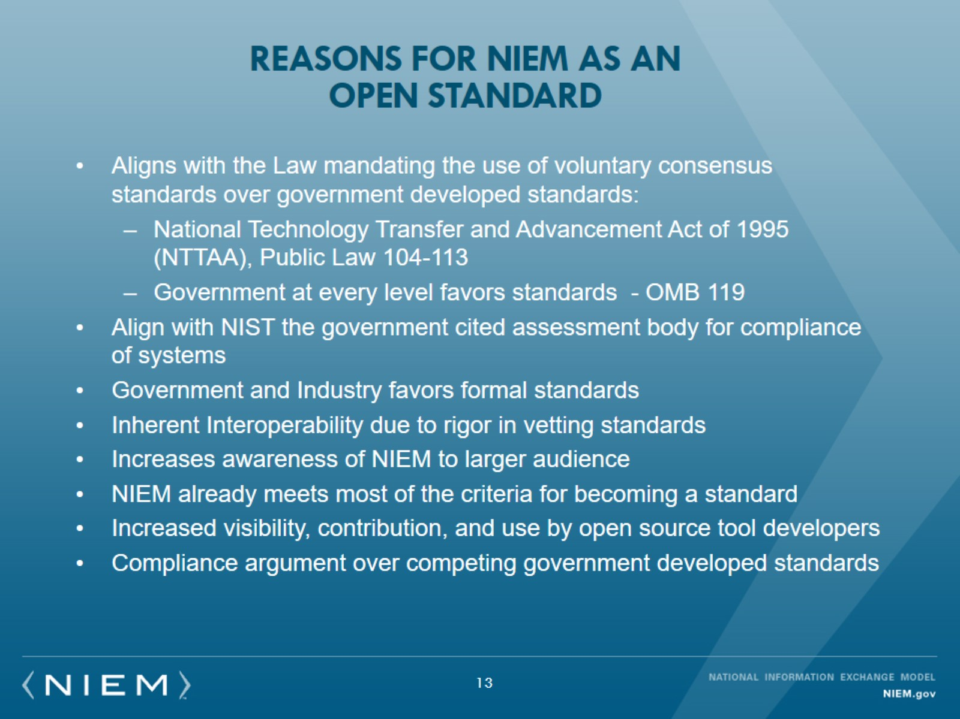
Reasons for NIEM as an Open standard

Slide 12
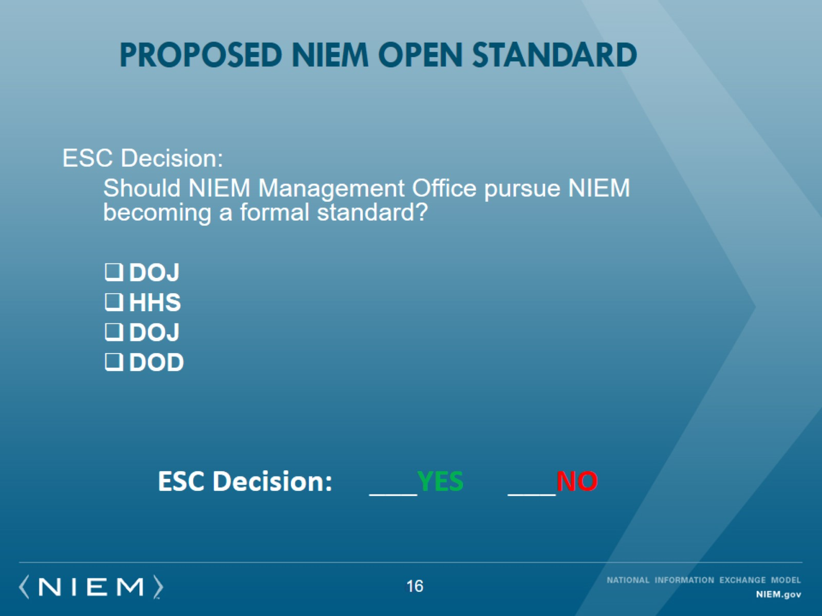

Proposed nieM Open Standard

Slide 13
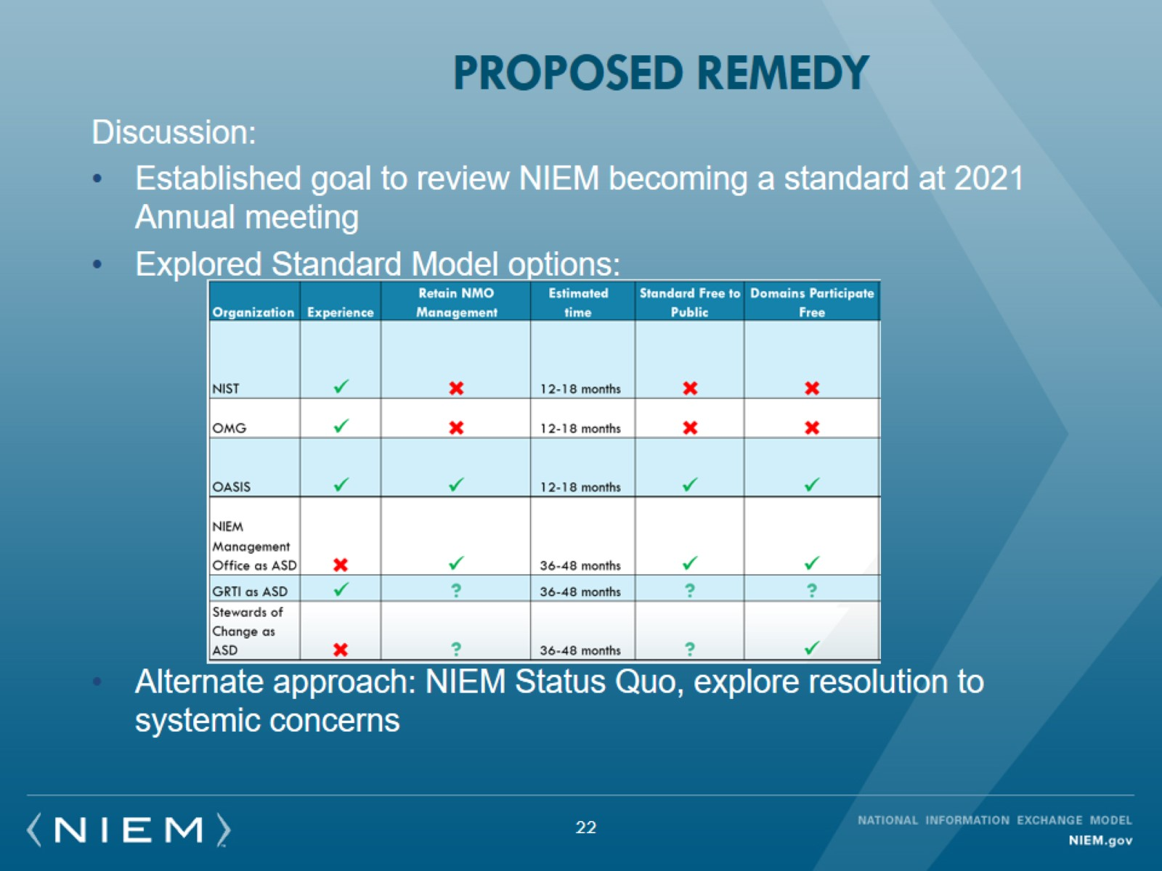
Proposed Remedy

Slide 14
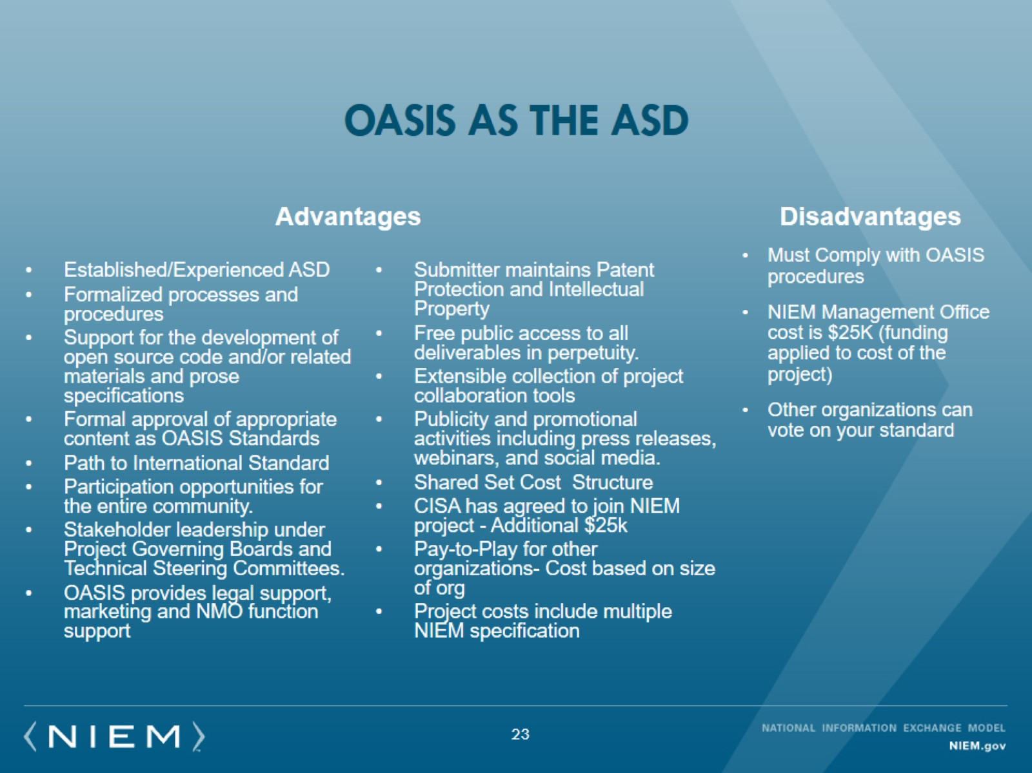
OASIS as the ASD

Slide 15
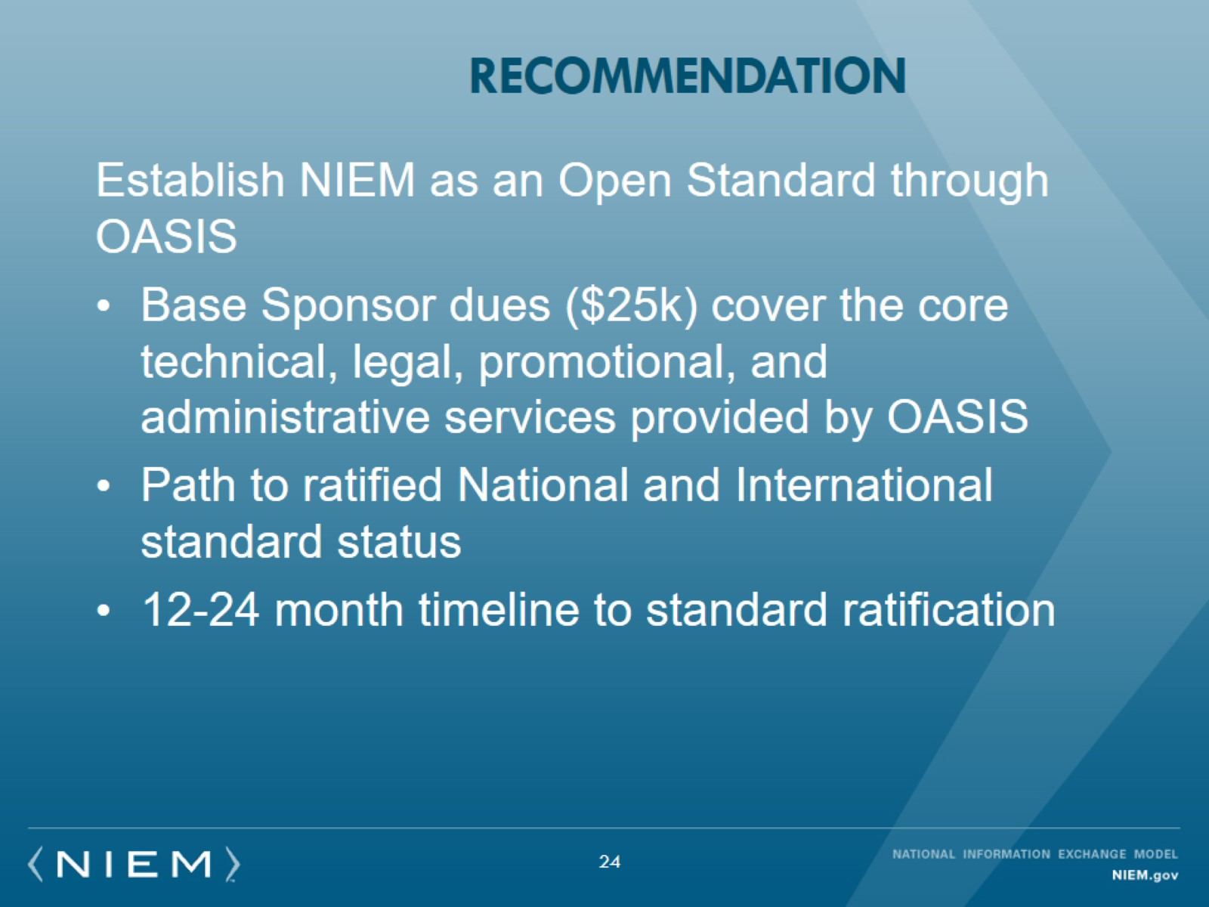
Recommendation

Slide 16
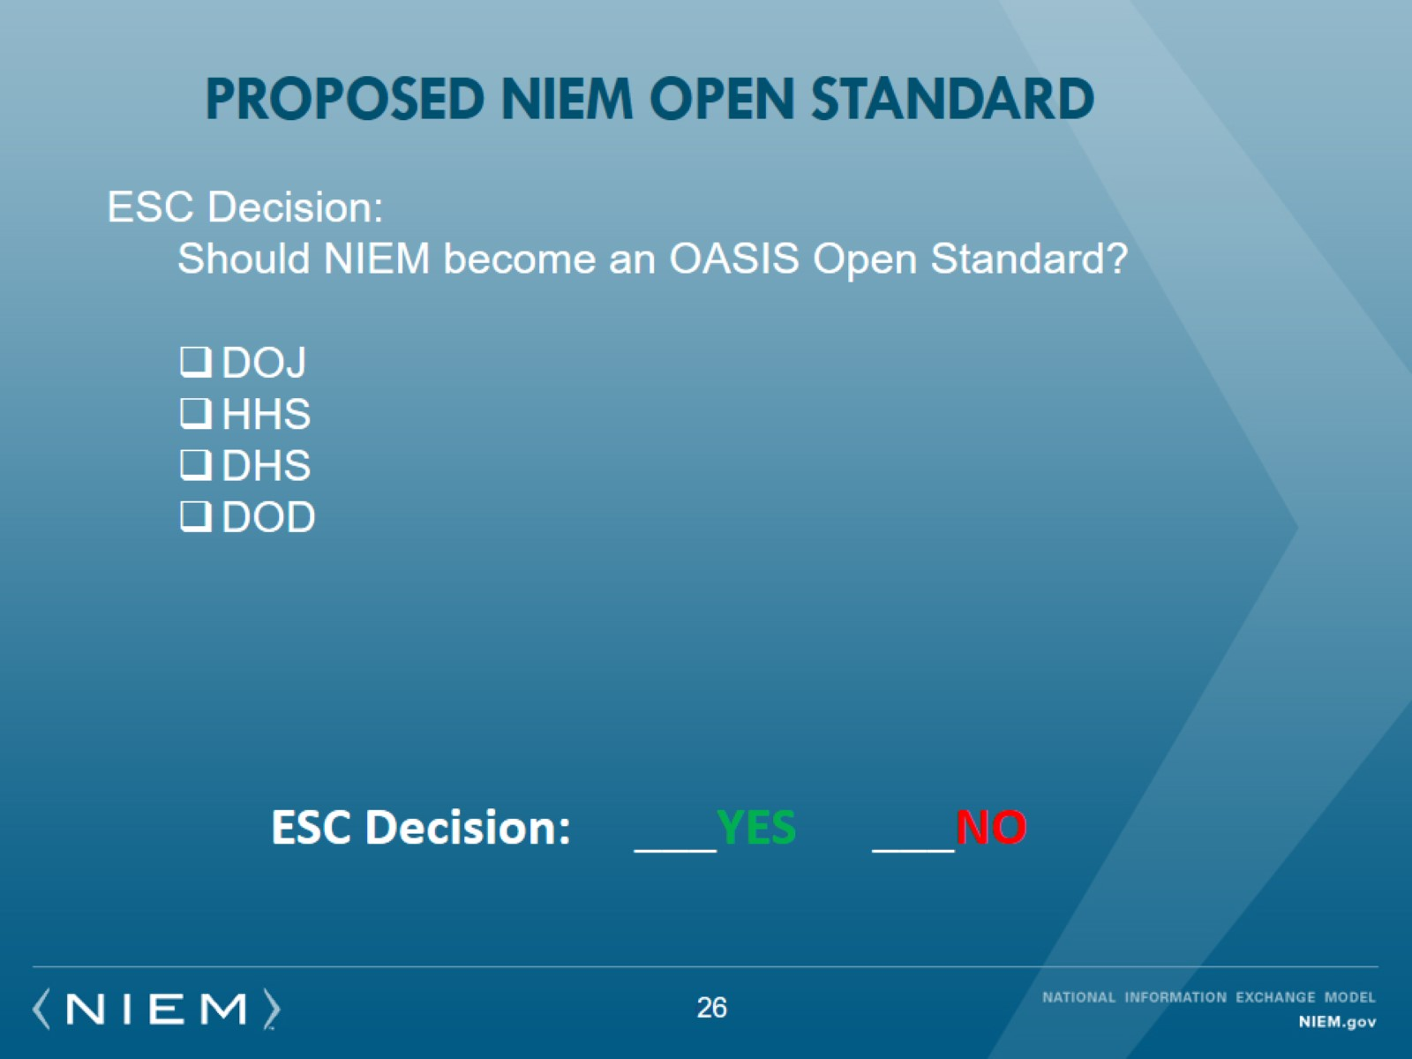
Proposed nieM Open Standard

Slide 17
Executive/Plenary Session
Highlights
NIEM Governance Review and Decision
17

Slide 18
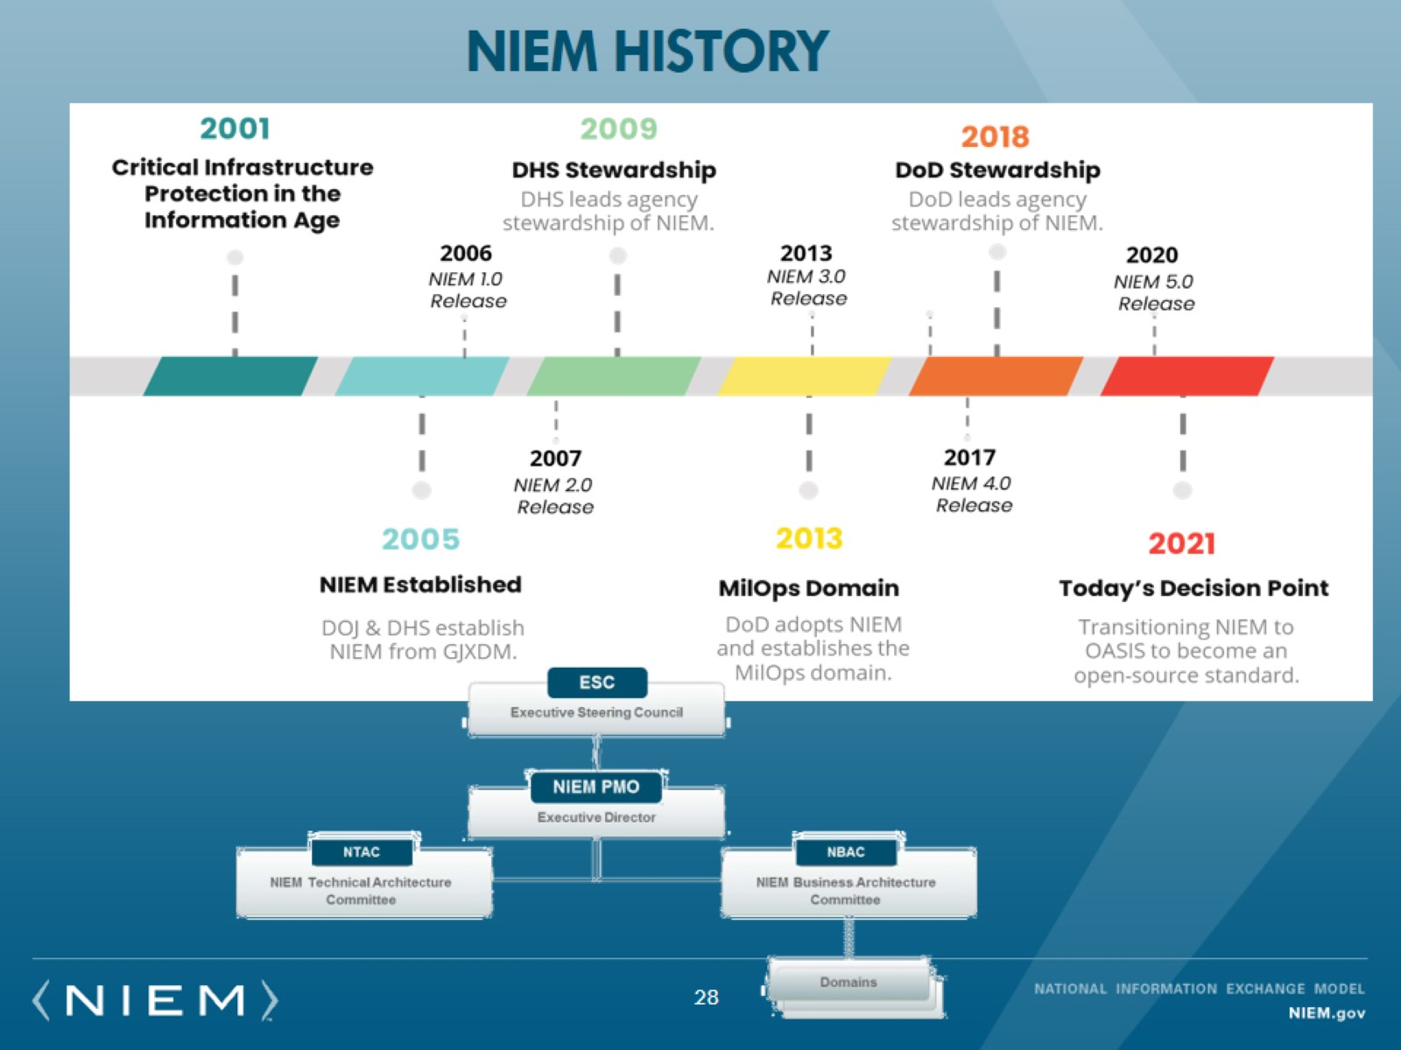
NIEM HISTORY

Slide 19
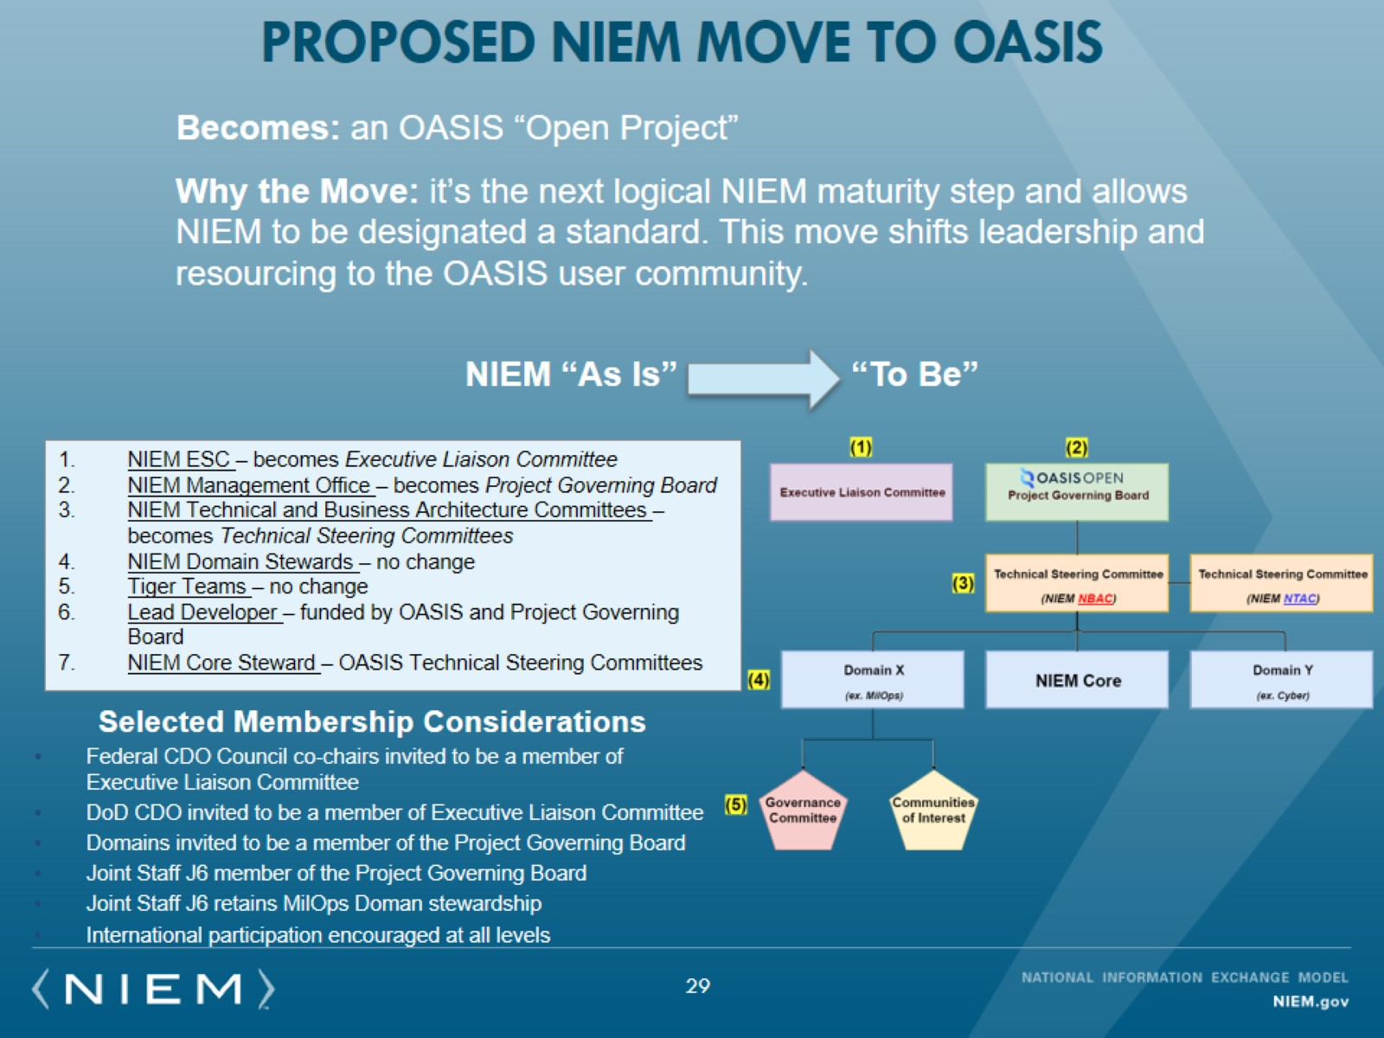
Proposed NIEM Move to OASIS

Slide 20
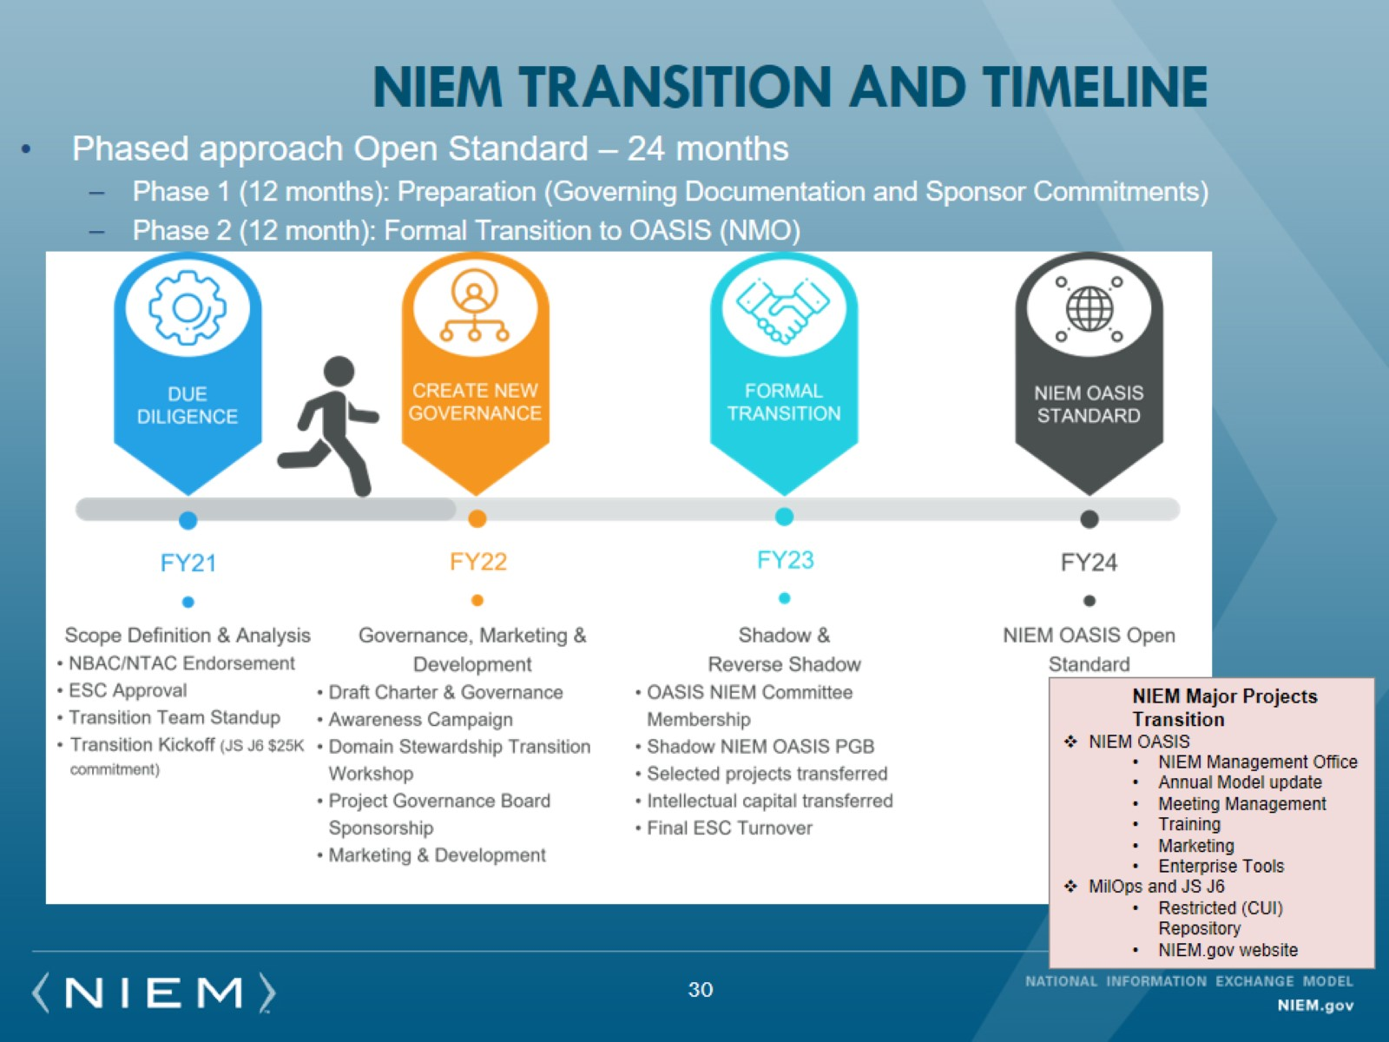
NIEM Transition and Timeline

Slide 21
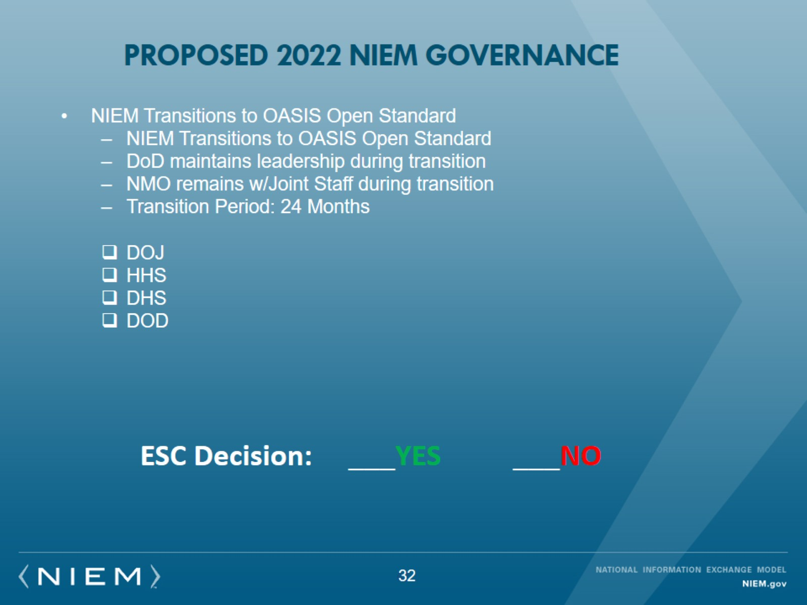
Proposed 2022 nieM gOVERNANCE

Slide 22
Executive/Plenary Session
Highlights
New Domains
L&D (ADL) & IHS (Govt. of Canada)
22

Slide 23

Proposed: Establish Learning & Development Domain under ADL stewardship
ESC Decision:
Endorse NBAC’s recommendation to establish a new Learning & Development Domain
23
Notes:
New product advertising
5.0 Release
DAU Course
IEPD Registry
IEPD Tools
5.1 Release

Slide 24
Proposed: Establish NIEM international human services domain UNDER employment and social development /Government of Canada stewardship
ESC Decision:
Endorse NBAC’s recommendation to establish a new International Human Services Domain
24
Notes:
New product advertising
5.0 Release
DAU Course
IEPD Registry
IEPD Tools
5.1 Release

Slide 25
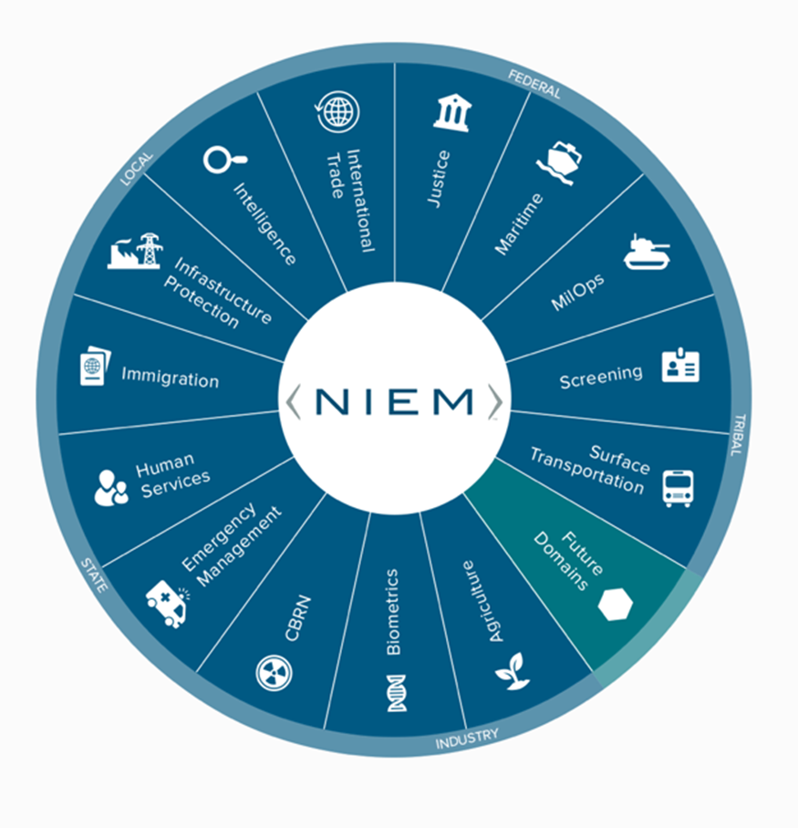
current - NIEM Domains (17)
Domains | STEWARD/Organization
Agriculture | VACANT, Garon Reeves/ USDA OCIO
Biometrics | John Boyd, Satish Sripada, Jennifer Stathakis, William Graves, Diane Stephens/ DHS OBM, DHS OBIM, FBI, DoD PM BIO, NIST
CBRN | Brendon Plapp/ DHS
CYBER | Brian Gattoni, Preston Werntz, Juan Gonzales/ DHS CISA
Emergency Management | Dan Cotter, Kamran Atri/ DHS, A4SAFE-DHS
Human Services | Tom Carlson, Dorothy Wan/ HHS AFC
Immigration | Curtis Ross, Jennifer Kish/ DHS USCIS
Infrastructure Protection | Preston Wertz, Juan Gonzales/ DHD CISA
Intelligence | Sue Dorr/ ODNI
International Human Services (New 2021) | Mr. Savoi Employment and Social Development Canada
International trade | Thomas Mills, Shailesh Sardesai DHS CBP
Justice | Kate Stilhol/ Nlets
Learning and Development (New 2021) | Dr. Sae Schatz ADL
Maritime | Sandra Brown, Kelly McCool/ OPNAV N9ID, N2N6IB
MilOps | Jeffery R. Jones, Ralph O’Connell/ JS J6
Screening | Steve Yonkers/ DHS
Surface Transportation | Dan Morgan/ DOT

Slide 26
Executive/Plenary Session
Highlights
Work Plan
26

Slide 27
Remainder of CY2021 Work plan
Major Goals
Start effort to make NIEM an Open Standard
Complete NIEM 5.1 minor model update and initiate NIEM 5.2 minor release
Conduct robust strategic communications engagements
Emphasize integration with emerging technologies – Meta Model (AI, Cloud, Cyber, UML, JSON)
Mature international alignment (Canada, FVEY, NATO)
Progress state, local, tribal, territorial engagements
27

Slide 28
FY2022 Work Plan
Tentative Major Goals
Update NIEM Governance
Advance Meta-model implementation
Plan execute 5.1 minor release
Implement International localizations to use NIEM
Launch monthly NIEM virtual training sessions
Establish persistent NIEM and NCDF Data Lake instantiation
Onboard Learning & Development and International Human Services Domains
Explore new domains
Encourage New Adopters: Education, NOAA Fisheries, Treasury (DAIMS), Veterans Affairs
Strong state, local, tribal engagement
DOD Leadership and Resource Sponsor Input Desired
28

